Slide 1
IBM Data Science Capstone Project
The battle of the neighborhoods
Justin Line
8/11/2020

Slide 2


Business Problem:
A client has hired me to help their company find a new location for their 5 star seafood restaurant business. They are trying to decide between opening the new business in Manhattan, NY or Paris France. Their preference is to first narrow down the city by researching market saturation. After that, they would like to identify the neighborhood that is best suited for the restaurant. The ideal neighborhood will have an average amount of restaurants, and few
VS

Slide 3
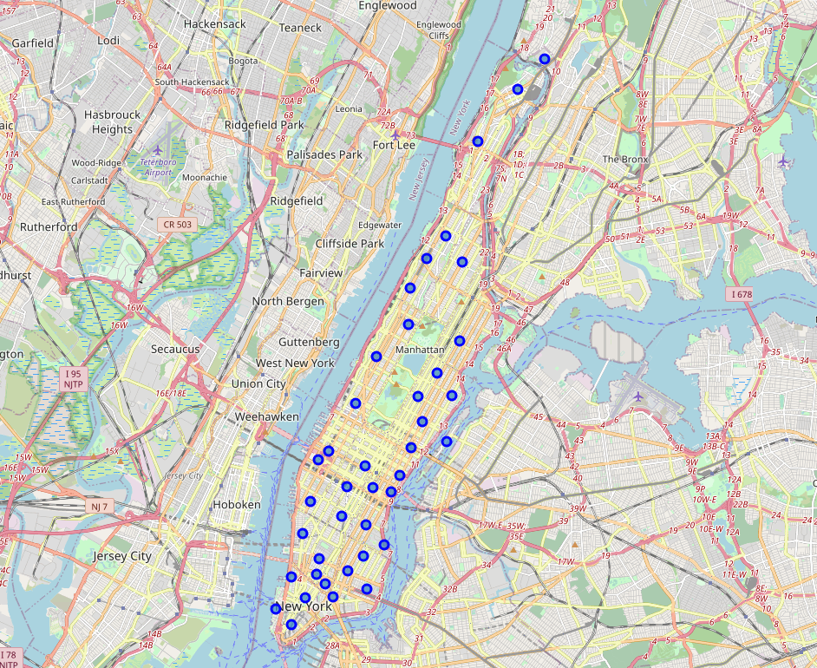
Comparing Locations:
Paris: 249 Restaurants in 1,000 meters, 22 Seafood (9%)
Manhattan: 62 Restaurants in 1,000 meters, 5 Seafood (8%)
Manhattan Selected

Slide 4
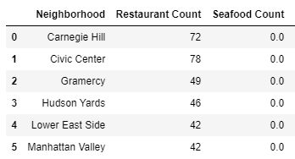
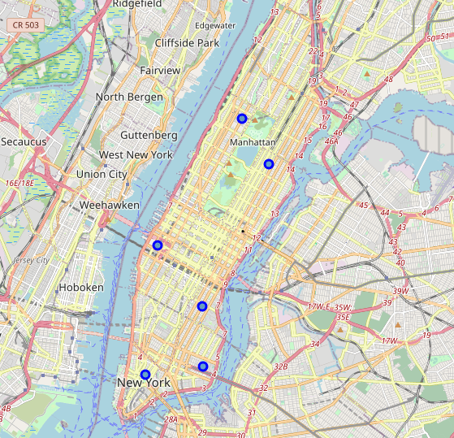
Neighborhood Selection:
To start to deep dive into the neighborhoods that would be the best for the new restaurant, I prepared a new call to pull in only restaurants around each neighborhood.
This gave me a total restaurant count, and allowed me to see what types of restaurants were available in each area.
Keeping in mind that our goal was to find a market that was not oversaturated, had little to no seafood restaurants, but had a solid dining out culture, I narrowed down the list to 6 neighborhoods that had between 30 and 80 restaurants, and 0 seafood restaurants.

Slide 5
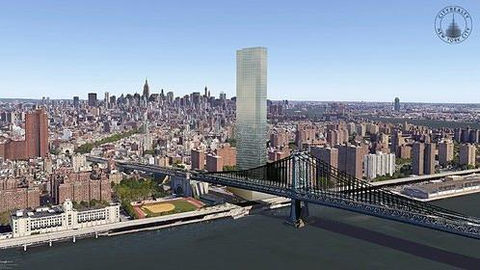
Results:
Lower East Side
Forty-two total restaurants, zero of which are seafood restaurants
5 restaurants in the top 10 most common venues, shows a healthy dining out culture
Art gallery and Cocktail Bar are also top venues in the neighborhood, which pair well with an upscale restaurant.

